Slide 1

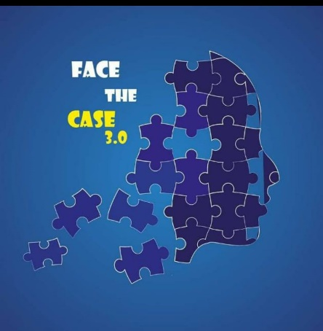


FACE THE CASE 3.0
Rise of AI: ChatGPT threats or Opportunities to Academia
Team: Cerebral Crew
Team Members:
Rizuanul Alam,
(Department of Electronics & Telecommunication Engineering, CUET)
2. GM Faysal Taisir,
(Department of Computer Science and Engineering, CUET)
3. Rayhanul Nayem
(Department of Mechanical Engineering, CUET)

Slide 2
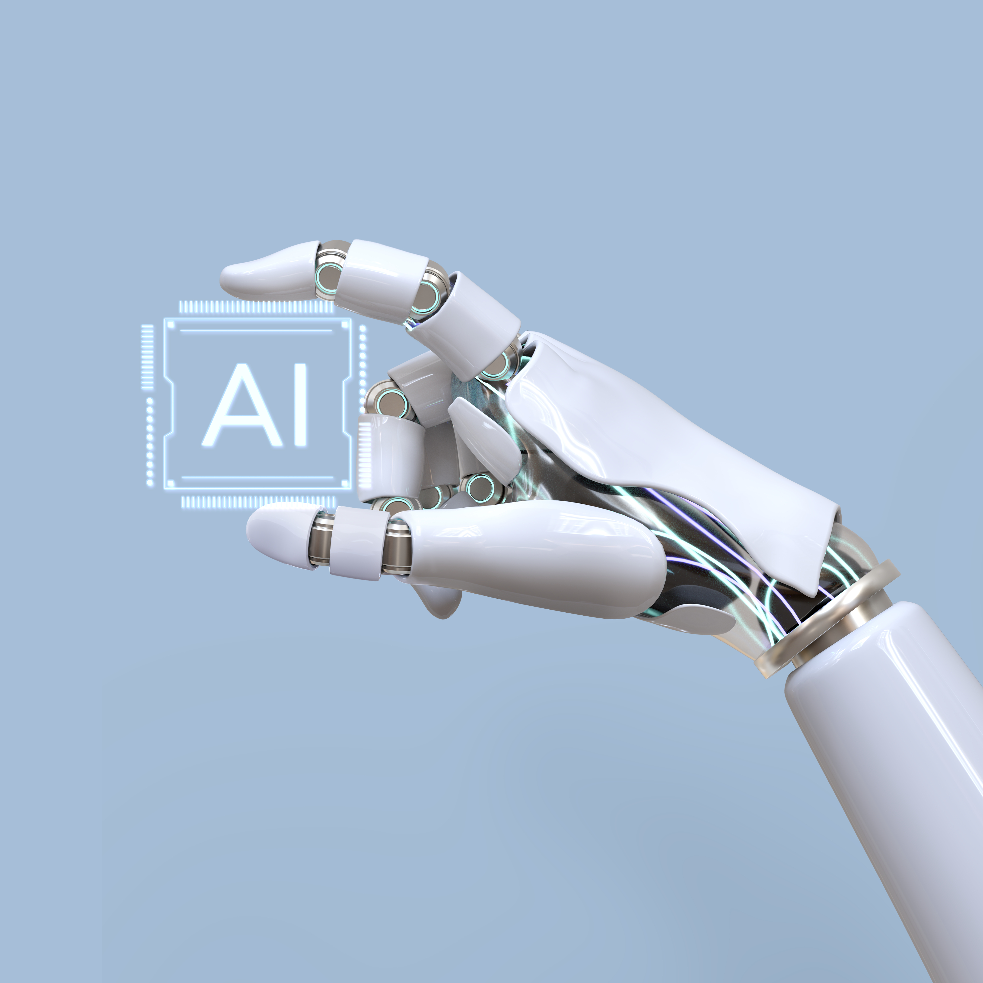


Welcome!
Let’s Explore AI in University!!

Slide 3






Outline
Introduction
Problem Analysis
Background Study
Key Challenges
Methodology
Proposed Solution
Assesment Model
Feasibility
Why Feasible
SWOT Analysis
Conclusion
Summary

Slide 4


Problem Analysis
The current scenario of University Education System
1. Universities are still lacking in use of AI.
2. Misuse of ChatGPT, an AI tool by OpenAI. Students are overusing this tool to complete their writing and assignments.
No Automation
Not Personalized
Lack of Flexibility
Outdated Curriculum

Slide 5

We have analyzed the key reasons why students are struggling with the current education system

Slide 6


Slide 7
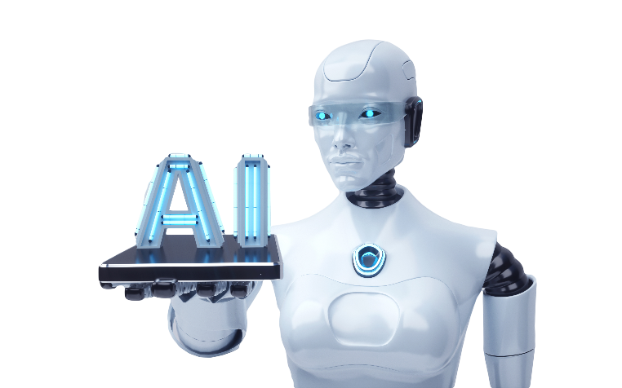



Key Challanges
The key challenge here is to build a AI model for the University Education System. To improve the operations of the current system.
Creating an Assessment model for detecting AI generated texts
Introduction
Background Study
Methodology
Feasibility
Conclusion

Slide 8

Proposed Model
We are introducing an AI model that will be functioned inside a central Blockchain made for the University
Both Students and Teachers will be connected with each other using this system
AI Model
For Students
For Teachers
Adaptive Testing
Virtual Learning Assistants
Intelligent Grading and Feedback
Automated administrative tasks
AI-Powered Learning Management Systems (LMS)

Slide 9

AI-Powered Learning Management Systems (LMS)
Personalized learning
Improved student engagement
Time-saving
Accessibility
AI-powered LMS can adapt to each student's learning style, pace, and preferences, and provide customized learning experiences based on their strengths and weaknesses.
AI-powered LMS can enhance student engagement by providing interactive and gamified learning experiences, personalized feedback, and targeted communication.
AI-powered LMS can automate administrative tasks, such as grading, feedback, and communication, saving time for both students and instructors.
AI-powered LMS can support students with disabilities or those who need additional assistance, by providing alternative formats for course materials, automated transcription, and captioning.

Slide 10



Virtual Learning assistant
Personal interface for Every Student
How can I start Learning Programming?
Clearing Doubts
Learning programming is an exciting journey, and it's never too late to start. Here are some steps to help you get started:
Choose a Programming Language: There are several programming languages available, each with its own strengths and weaknesses. Python and JavaScript are great for beginners, while Java and C++ are popular choices for more complex applications. Pick a language that fits your goals.
Track daily activities of the Student
Recommends based on the skillsets and weakness
Send a message
Recommends job opportunities based on his skill level

Slide 11
Adaptive Testing
Show Analytics
Academic Studies
Coding Round
Suggest Questions based on Current Skill level
Solve Questions
Solve Questions
View Resources
View Resources
Suggest Recourses to Study
Send a message

Slide 12

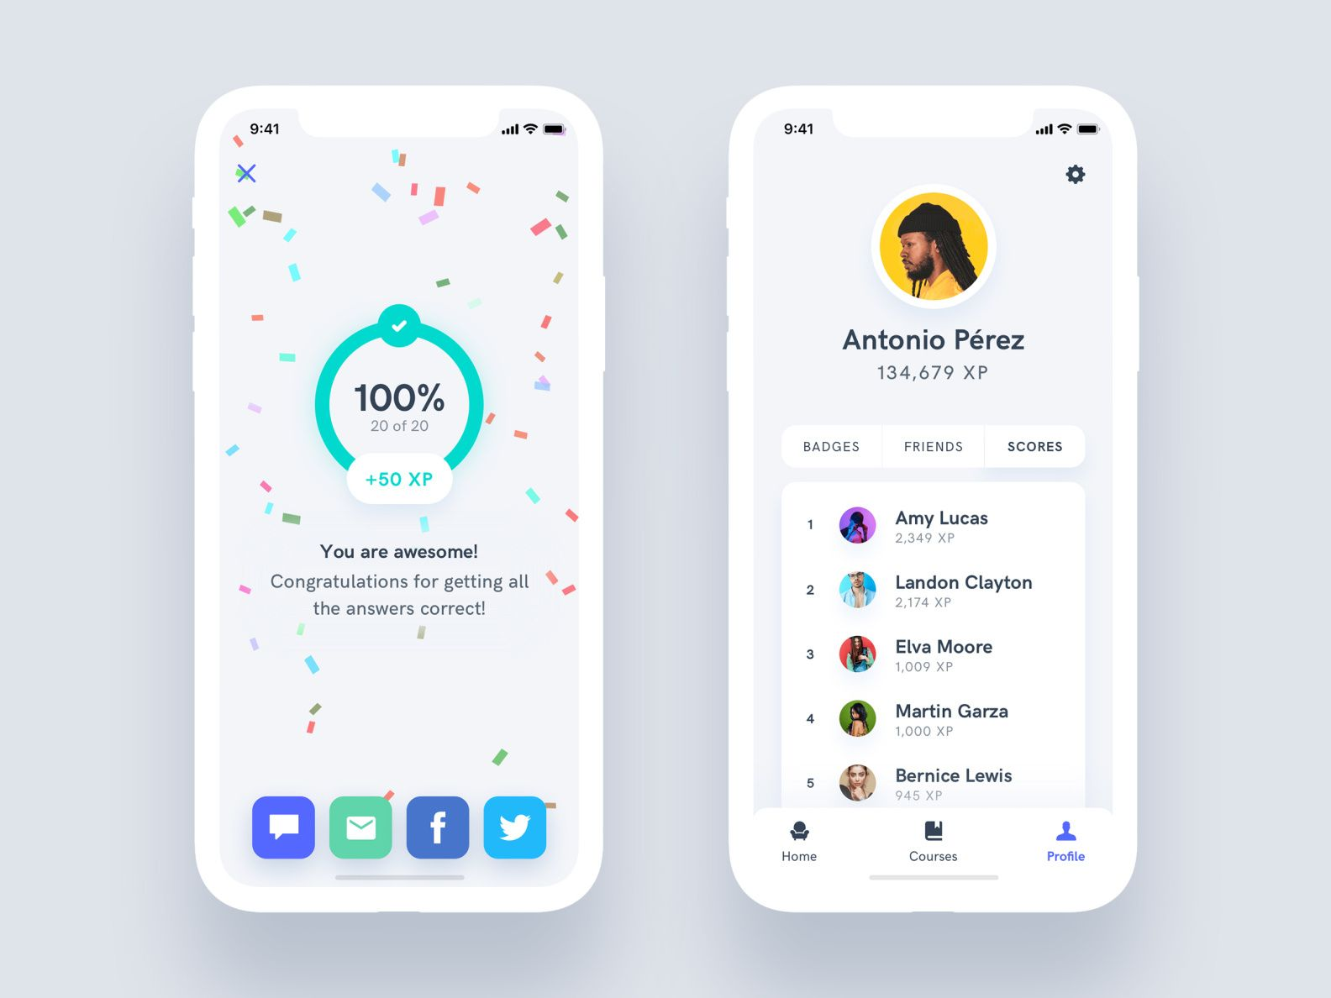
Intelligent Grading and Feedback
AI can be used to automate the assessment process. This would involve developing an AI-powered system that can grade assignments, essays, and exams. This will :
Reduce workload
Save Time
Faster feedback
No grading Bias

Slide 13

Intelligent Grading and Feedback
There will be a central leaderboard both for inter departmental and intra departmental. The marking and grading is done automatically by AI. Also the leaderboard keeps updating by AI
Weekly Top performers will be rewarded
Students will become more competitive
Students will be more focused on ECA

Slide 14


Automated administrative tasks
Class Scheduling, Attendance Tracking has always been a big headache for the tutors.
This problem can be solved by using AI. The classes will automatically be synchronized with other teachers classes and teacher will be notified if any free slot is here

Slide 15

Assessment Model
We are introducing a 5 Point assessment model can detect the presence of artificial intelligence in students writings.
We will use a NLP (Natural Language Processing) Algorithm for the whole model
AI-generated content may lack the nuances and idiosyncrasies of human writing, resulting in a uniform style and tone throughout the text.
Some AI-generated content may include code or metadata that reveals the use of an AI model.
Style and tone
AI models can generate repetitive phrases or sentences as they rely on algorithms and statistical patterns.
Source Code
Repetition
AI generated texts may sound unnatural or robotic.
AI-generated content may contain factual or logical inconsistencies
Unnatural language
Inconsistencies

Slide 16
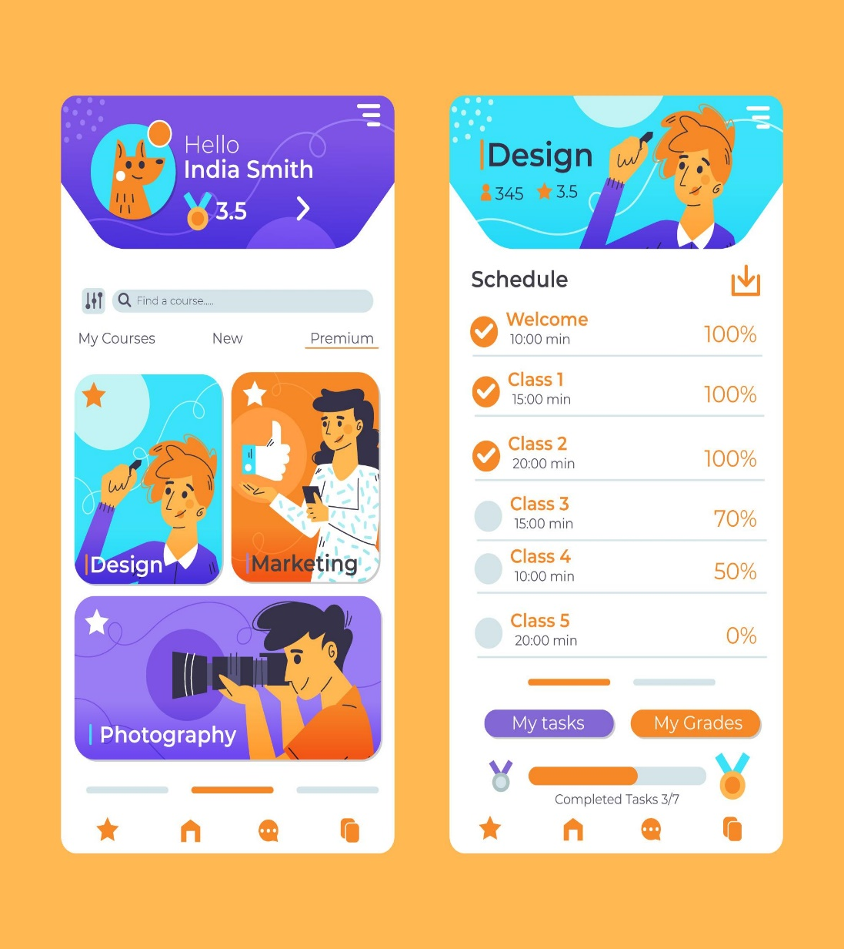
Assessment Model
The Assessment model will work based on Natural Language Processing. This model will be trained with large set of data for improving efficiency
The assessment and marks will only be available to the student. Students can always take from tutors personally using the mobile app
How the Model works
1
2
3
4
5
ANALYZES REPETITION
CHECKING INCONSISTENCIES
ANALYZES UNNATURAL LANGUAGE
ANALYZES STYLE AND TONE
CHECKS THE SOURCE CODE
AI can not think like human. So their writings are inconsistent in many cases. This is another step for assessment
The AI models are trained using various patterns and examples. So they often produce unnatural language
This is first and easiest step. If any metadata is found then the content can surely be marked as plagiarism
Analyzing repetition of words, the model can also find a common pattern.
Analyzing the writing tone is a bit tough. Using NLP algorithms we can accomplish this.

Slide 17

Why Feasible
Installing a Blockchain for The University is not something very difficult.
The whole solution is based on using AI models. We need some lines of code and programmers to spend their hours for creating a better education system for the University

Slide 18

Why Feasible
However, followings are the key challenges to the feasibility:
Managing a huge Database.
Security of personal chats with tutors.
Efficient Server uptime
Making teachers and students aware of the system.

Slide 19
This is a sample demonstration of how much time can be saved after using the AI model in current education system, based on assumption

Slide 20
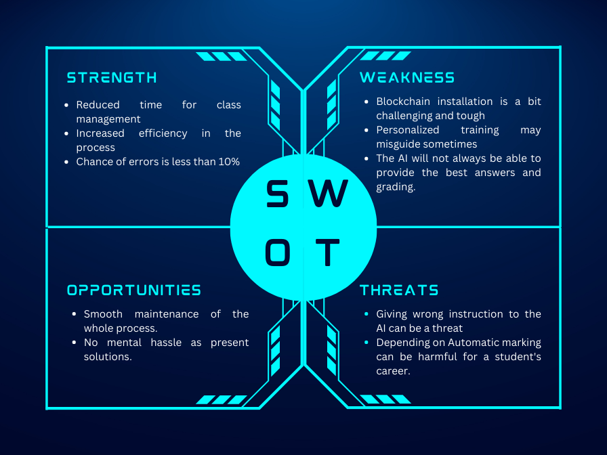
SWOT Anaylsis

Slide 21


Summary
In conclusion, incorporating Artificial Intelligence in the University Education system presents both opportunities and challenges. While AI can provide valuable tools to enhance learning, it is important to use it as a supplement to education rather than a substitute for it.
By adopting a balanced approach and using AI responsibly, universities can better equip students with the skills they need to succeed in today's rapidly evolving world

